Slide 1
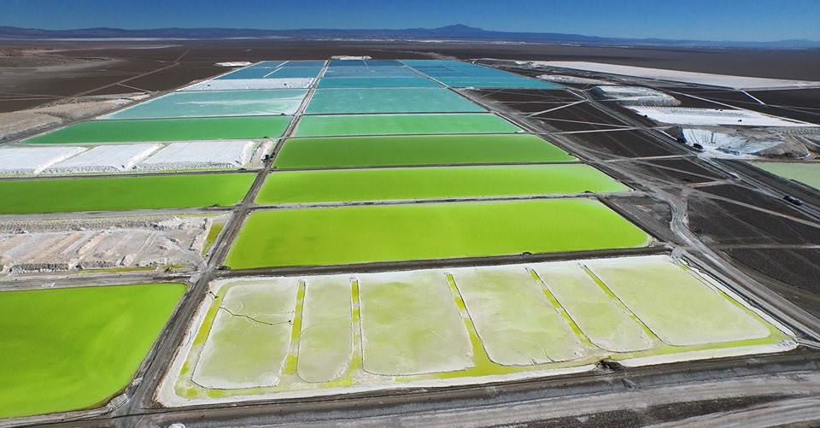
Lithium Mining and Extraction
Where are our batteries derived from?
Soquimich mine, Chile

Slide 2
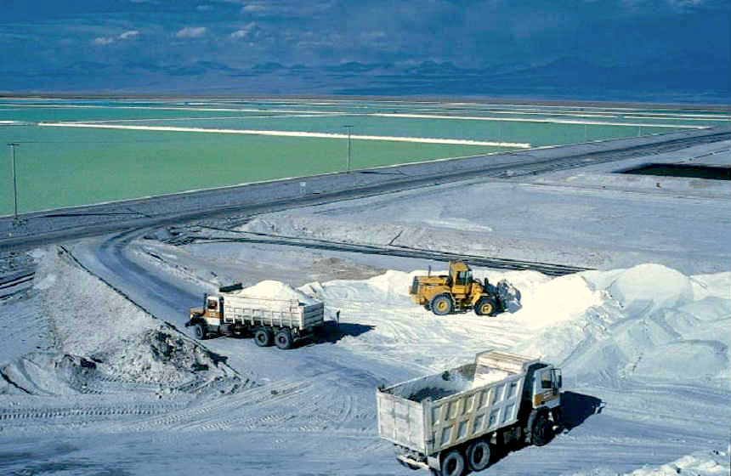
What is Lithium Mining?

Slide 3
Background Information on Lithium Mining
Lithium: the chemical element of atomic number 3, a soft silver-white metal, and the lightest of the alkali metals.
lithium mining is a set of chemical processes where lithium is isolated from a sample and converted to a saleable form of lithium.
Two major sources which humans extract lithium from include mines and brine water. (Brine is a high-concentration solution of salt in water)
Most lithium mine productions who extract the lithium through mines have been priced out since the early 2000’s, since the cost of extracting lithium from hard rock is estimated to be double that of producing from brines.

Slide 4
Background Information on Lithium Mining (Brine Water) Continued…
For producers to extract lithium from brines, the salt-rich waters must first be pumped to the surface into a series of evaporation ponds where evaporation occurs over a number of months. Since solar brines are naturally positioned at high altitudes and in areas of low rainfall, evaporation is an ideal and a cost efficient method of harvesting lithium.
When the lithium minerals have reached an optimal concentration, the solution is pumped by the manufacturing plant where extraction and filter removals of other minerals like boron and magnesium occurs.
Finally, the lithium which is filtered and dried, is ready for use in our everyday lives.

Slide 5
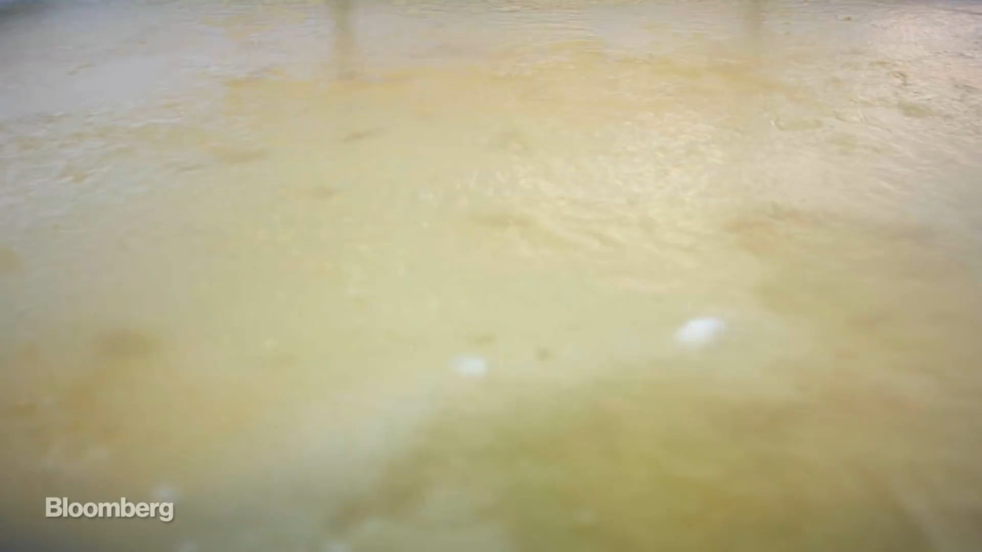

Slide 6
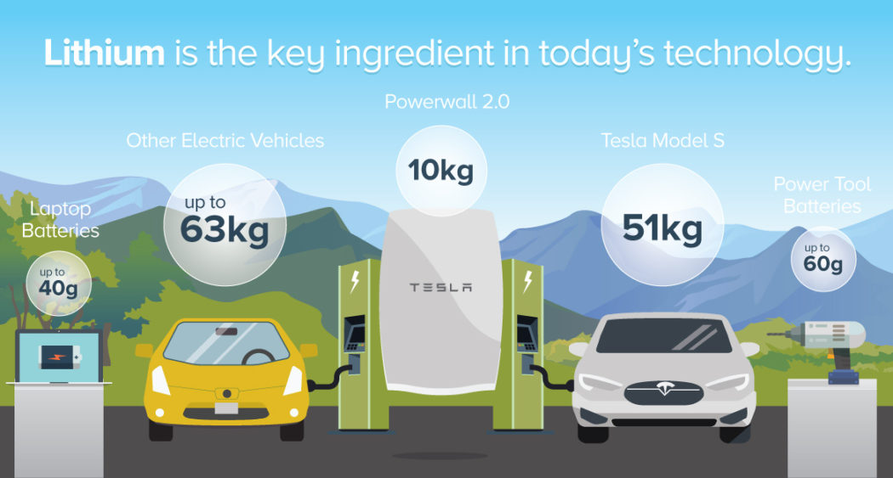
Lithium Mining and Extraction’s Dilemma.
Lithium is the common metal used in our batteries; your toys, phone, computer and many more appliances use lithium-ion batteries.
The mining methods used to harness this precious metal are being done on every continent on Earth, apart from Antarctica.
The by-products of the mining have detrimental effects on local wildlife and civilization, but it seems that any protests to the mining are futile.
- Mass of lithium needed for various pieces of technology in today’s world

Slide 7
Lithium Mining and Production in 2016 (Tonnes)

Slide 8
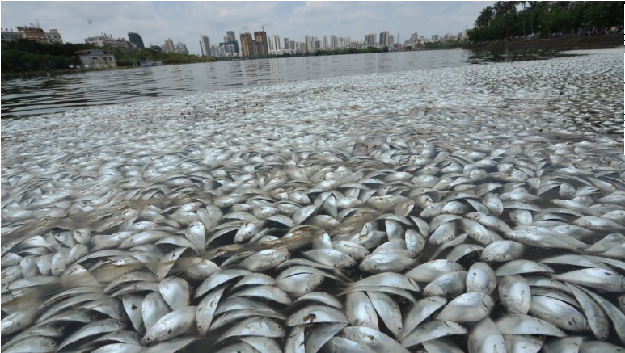
Effects on you and the Environment
People like us don’t really have any negative effects on this lithium extraction, as we don’t live near areas where this mining happens- we are profiting from it.
People in countries like China, Argentina, Chile, and the other countries that see heavy mining are affected the most.
They are drinking water that has by-products of the mining, which can cause cancer, headaches, fever, and even death.
35 Tones of dead fish in a river in Hianan Province, China. C.2016

Slide 9
The Stakeholders and their Victims
There are various companies that are mining for lithium around the world, but there are a few big ones.
SQM is the world's largest lithium producer, with mines in the world's biggest mines on every continent.
Albemarle, FMC, are among the top 3 producers.
China has two of the largest producers; Tianqi Lithium and Jiangxi Ganfeng Lithium.
China has the worst of these by-products from these companies, as sanitation and pollution control is non-existent. China is expected to be the world leader in lithium production soon.
They have a huge population density, and this makes people very prone to contracting illness from one infected river.
They also have a huge industry for fishing, and the lithium by-products kill tons of fish, which provide a living for millions.

Slide 10
Quick Fact
The 5 aforementioned companies have a combined market cap of US$38 Billion dollars. That shows that there is a huge interest in lithium mining from the public, which will result in a huge growth for these companies.

Slide 11
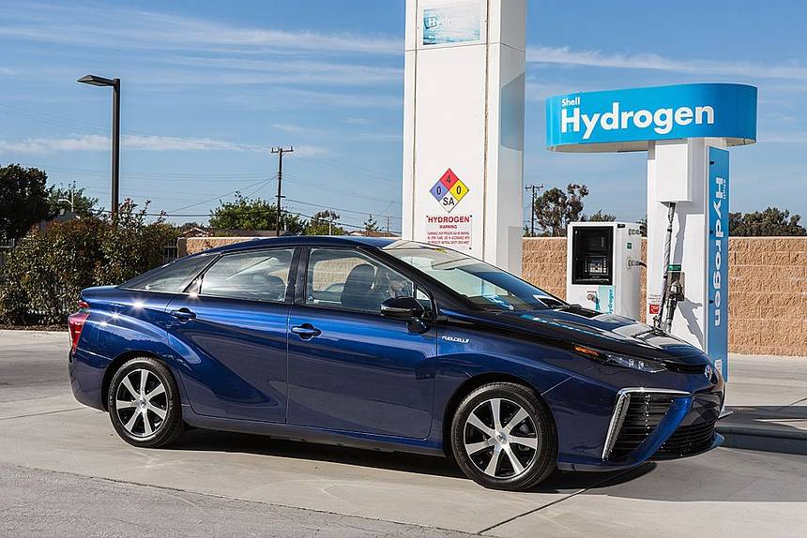
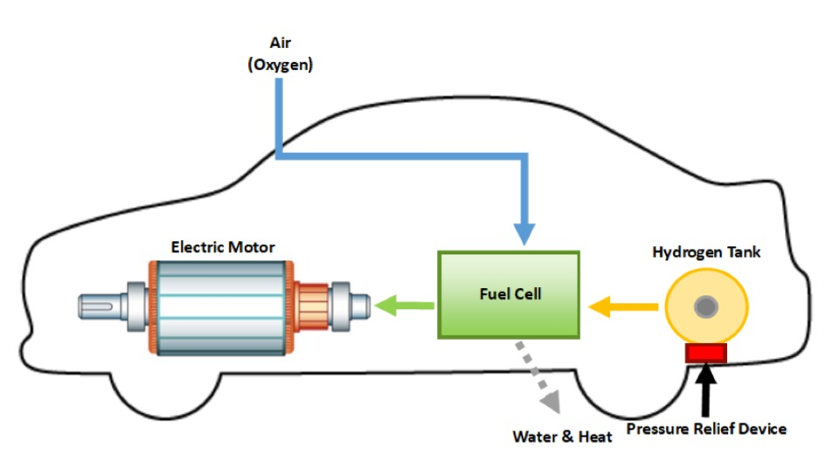
Possible Solutions to Lithium Mining and Extraction
Hydrogen Fuel Cells
In a fuel cell, it combines hydrogen and oxygen to produce electricity, heat, and water. This will then convert the energy produced by a chemical reaction into a usable electric power.
In a fuel cell, it will produce electricity as long as fuel (hydrogen) is supplied, making it never lose its charge.
Hydrogen fuel cells are a promising piece of technology as a resource for heat, electricity for infrastructure and electrical power for electric motors propelling vehicles.
In the future, hydrogen fuel cells can be used as a resource for energy carriers. These are carriers that move and delivers energy in a usable form to consumers. Like the sun and wind, fuel cells are a renewable resource that can transport or store electricity to where it is needed.
Unfortunately, the modern day cannot manufacture hydrogen without using fossil fuels first, which defeats the purpose of helping the environment.

Slide 12
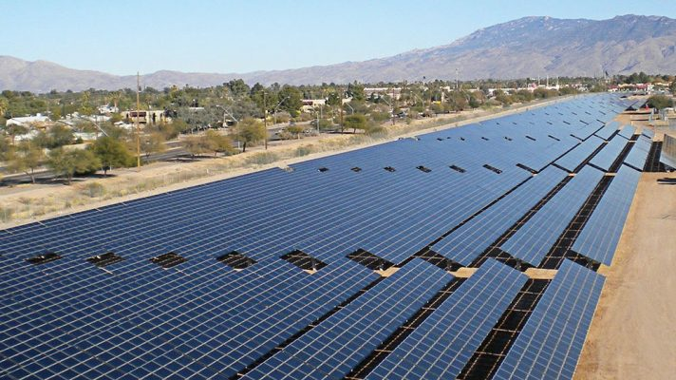
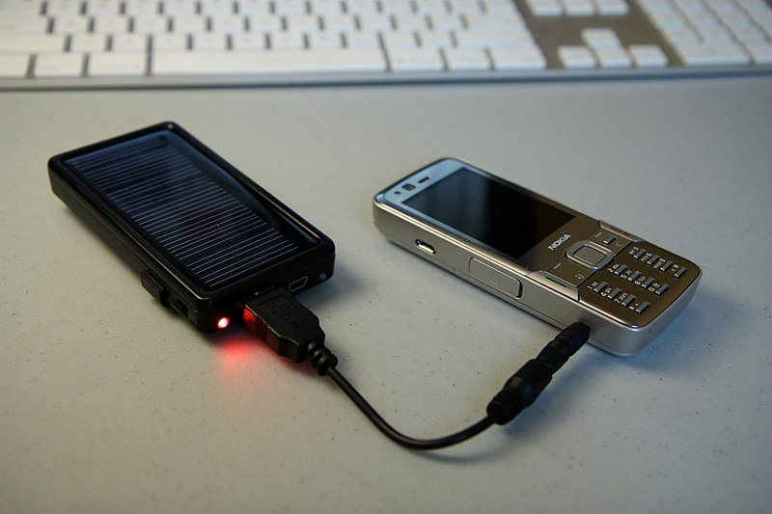
Possible Solutions to Lithium Mining and Extraction Continued…
Solar Panels
In the modern day, solar panels are not as efficient as we may want, in order to provide enough power.
According to Elon Musk, his team is putting serious work into the solar roof, nanotechnology will provide an evolved leap on technology.
In the future, solar panels could be capable of being well enough to power an entire car by being entirely self-sufficient .
Solar cell phone chargers also consist of solar panels; used to charge cell phone batteries. They are an alternative to the standard electrical cell phone chargers (lithium-ion battery chargers) we use in the modern day. In some cases, these chargers can be plugged into an electrical outlet.

Slide 13
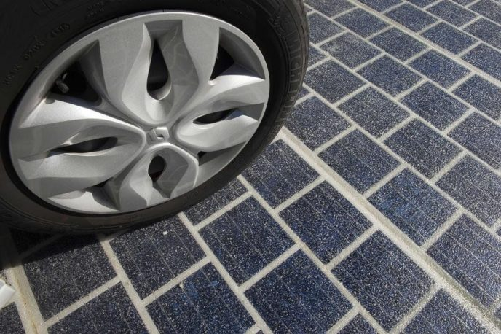
Possible Solutions to Lithium Mining and Extraction Continued…
Powered Roads
There is a such thing as powered roads, which allows for the road to act as power source and the car effectively works like a slot car racer as it absorbs the power.
We would be able to take out the batteries sitting under the hood of each car, making all vehicles lighter and inflict less damage on the road.
But we do face the problem of the investment we need for the infrastructure. We also cannot take away all batteries from the cars until the whole road network has power. It may be possible that this can be a possible alternative lithium batteries used in cars.

Slide 14
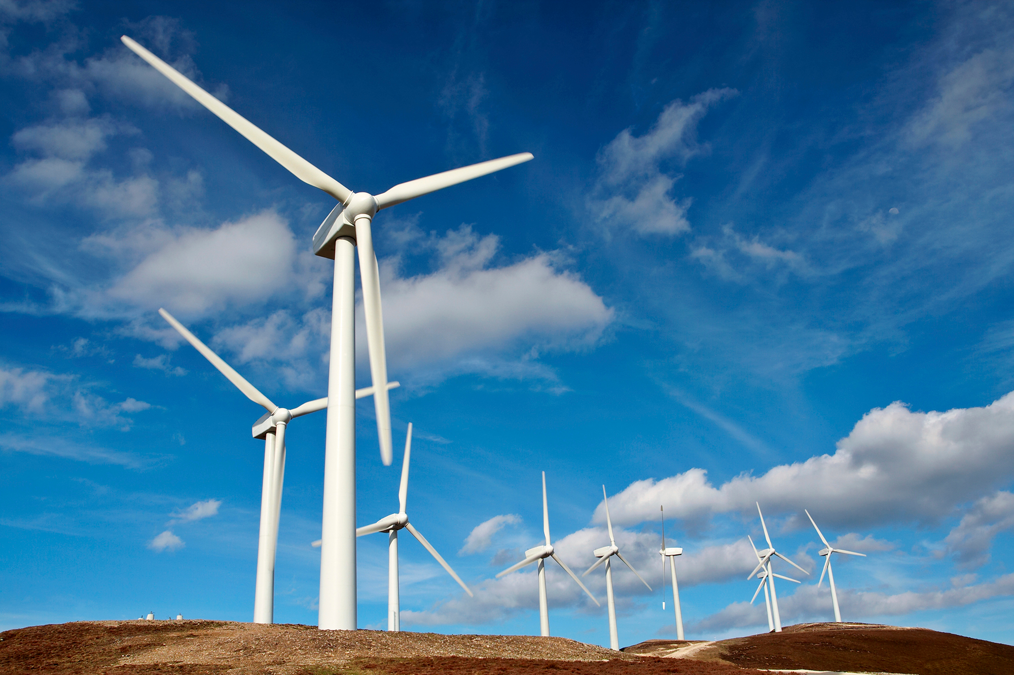
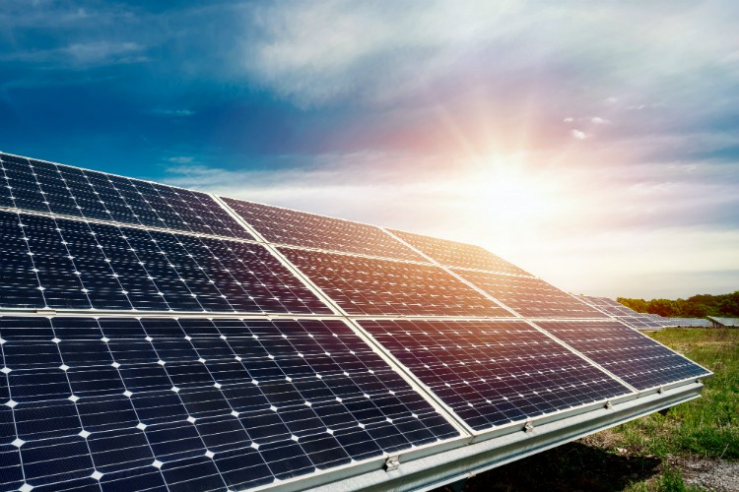
Solution to Human Behaviors Regarding Lithium Mining and Extraction
The attitude of humans in modern day towards environmental issues is changing, in a great way, as we are responding potential disastrous climate change and global environmental degradation.
A global energy transition that we’ve taken a part of is to limit ourselves from burning more fossil fuels for energy and transportation, but rather look for alternatives for the power we need such as renewable non-polluting solar and wind energy. Therefore, we must continue this transition.
What humans can do is by consuming more energy from renewable resources than they do with non-renewable resources. For an example, you can attach solar panels on the roof of your house, generating a flow of electricity (as the photovoltaic cells will convert the radiant energy to electricity).

Slide 15
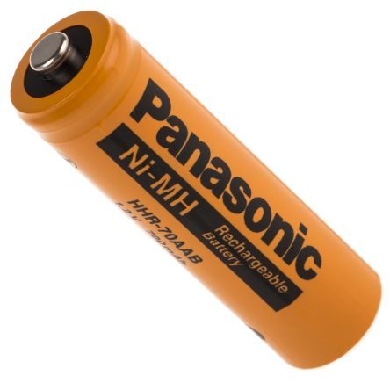
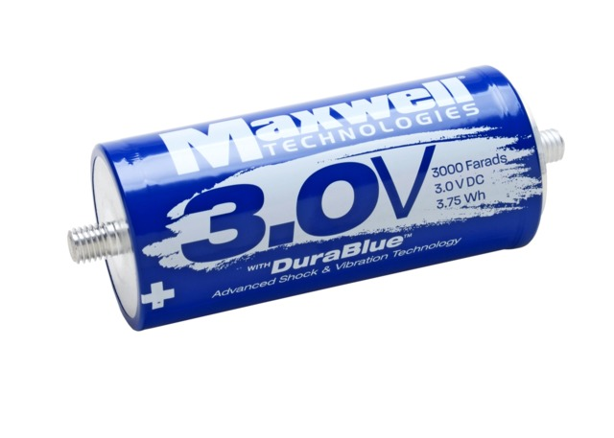

Solution to Human Behaviors Regarding Lithium Mining and Extraction
Some common ways humans can change their behavior towards the environmental issue behind lithium mining, is to use energy storing objects that don’t include lithium; like rechargeable batteries and supercapacitors and ultracapacitors.
In a rechargeable battery, you will have the advantage of having up to 1800 charging cycles, making it cost efficient in a long term basis. This will contribute less waste to landfills and will contain less toxic materials.
Supercapacitors and ultracapacitors are solid state devices that offer advantages over batteries in lifetime, power density and adapt to temperature changes. Ultracapacitors are storage cells that provide quick, massive bursts of instant energy and can be found in many electronics, from computers to cars. Although the ultracapacitor can only store about five percent of energy that a regular lithium-ion battery has of the same size, they are environment friendly since they can be used for thousands of cycles and contain low toxicity of materials.
- Rechargeable battery
-ultracapacitor

Slide 16
https://www.research-tree.com/blogs/insights/4-lithium-mining-stocks-to-watch-and-why
http://www.lithiummine.com/salt-evaporation-ponds
https://www.thebalance.com/lithium-production-2340123
http://www.lithiummine.com/lithium-mining-and-environmental-impact
https://dgit.com/10-alternatives-lithium-ion-batteries-4242/
https://www.renewableenergyworld.com/hydrogen/tech.html
http://www.mining.com/web/why-lithium-why-now/
https://gcell.com/knowledge-hub/alternatives-to-batteries

